Slide 1
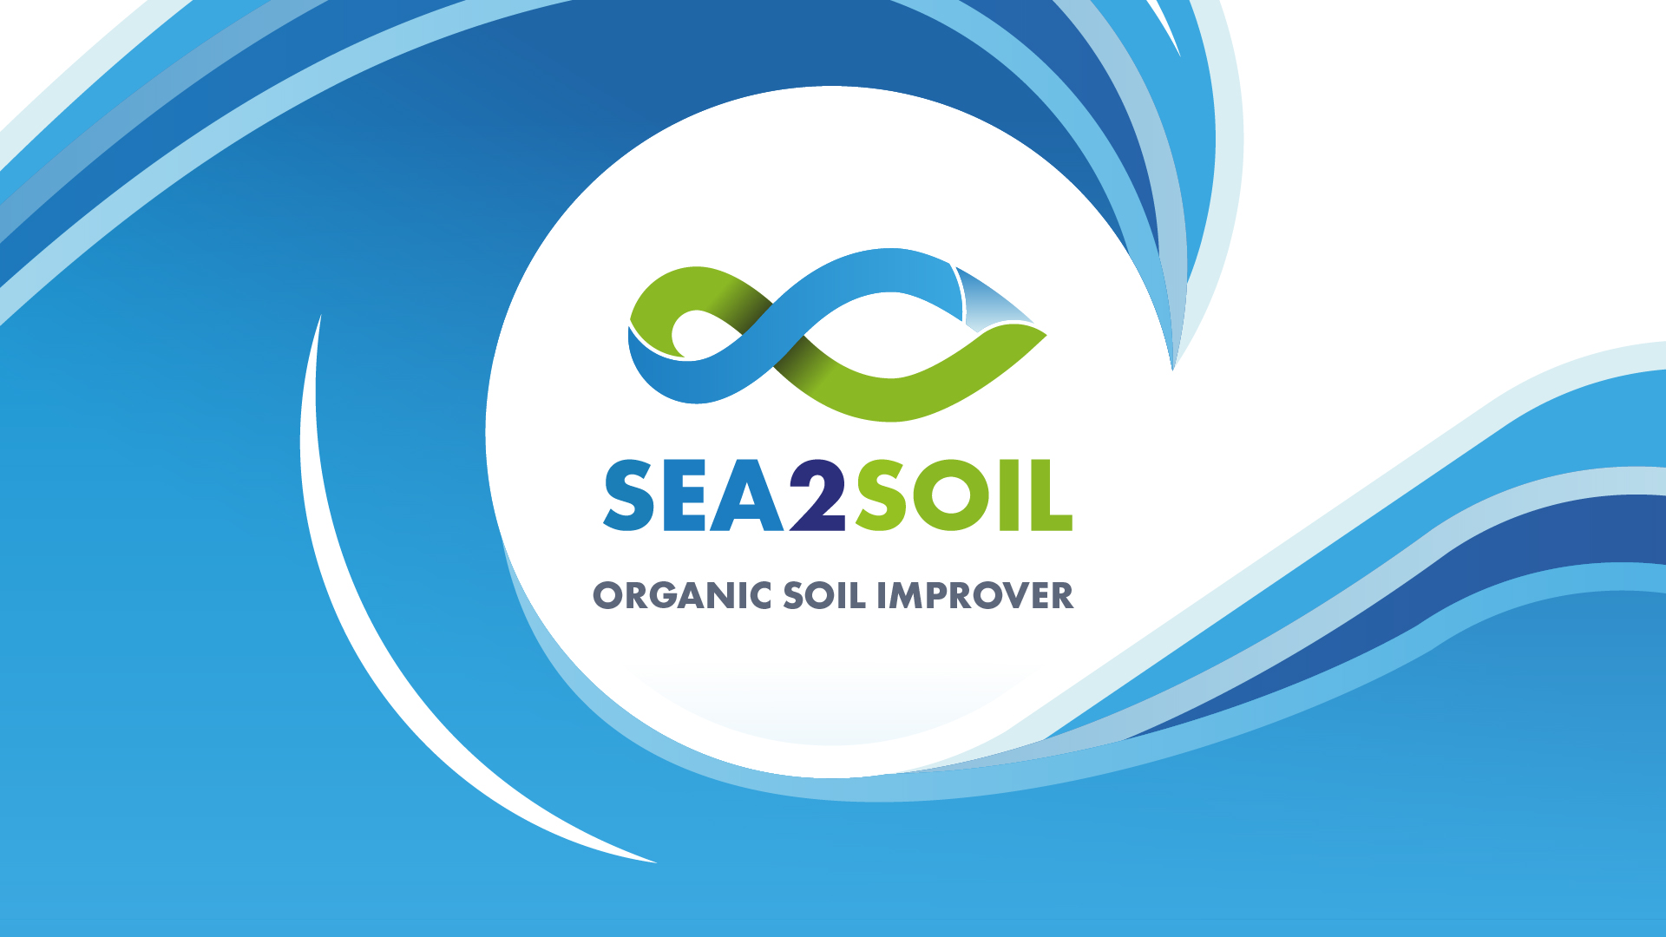

Slide 2
Soil Biology
Increase Soil Biology is important for several reasons
  Nutrient Cycling
  Soil Health and Structure
  Improved Rooting
  Plant Health and Growth
  Water Regulation
  Disease Suppression
  Decomposition and Organic Matter Breakdown
  Carbon Sequestration

Slide 3
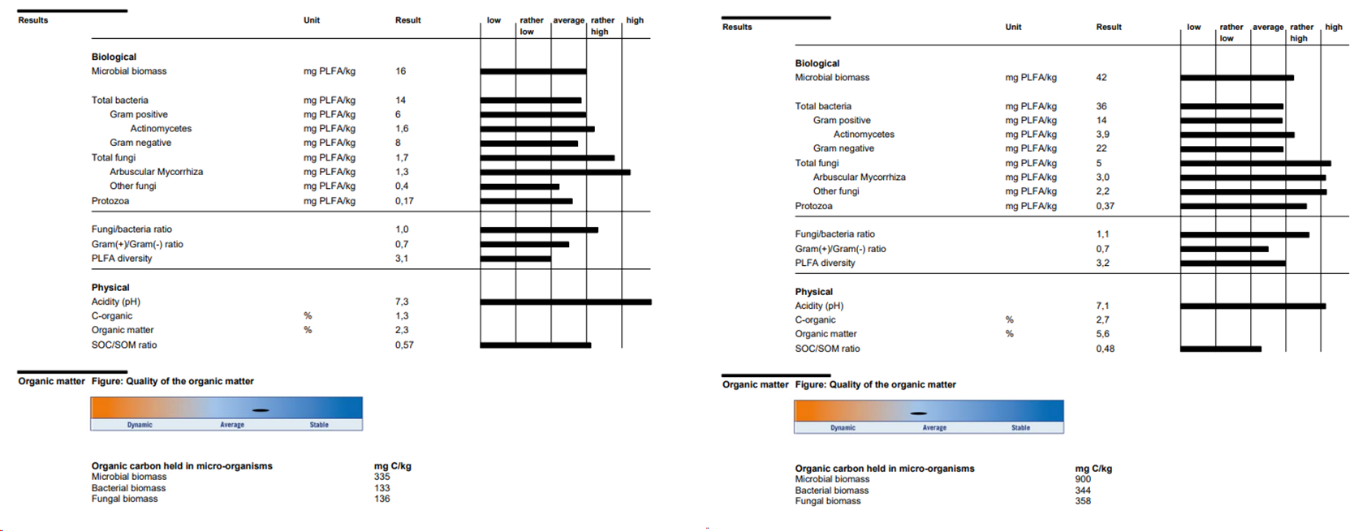
Initial results – Soil Life

Slide 4
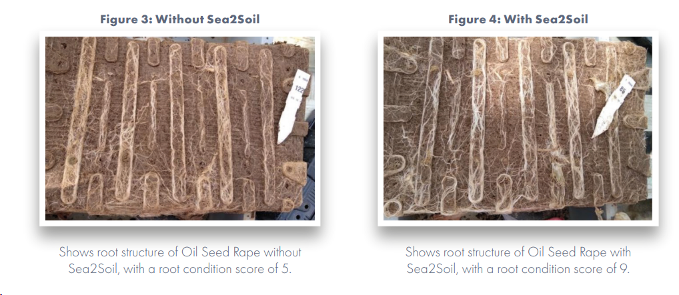
Initial Results - Rooting

Slide 5

Collaboration with Sutton Bonington

Slide 6
Background
To assess the effective impact of Sea2Soil on soil physical properties, biology and chemistry.
  By stimulating the soil microbial and mesofauna communities
Phase One
  Quantify
    Key physical, chemical and biological properties.

Slide 7
Farm Background
Farms:
  Test Farm - Girsby Grange, Brugh on Bain LN8 6LA, been using Sea2Soil for 3 years
  Control Farm – Neighbouring farm, conventional “synthetic” farming
Test Date: 31st May 2024

Slide 8
Earthworms
Play an essential role in agriculture due to several key functions
Soil Aeration
  They create channels that allow air to reach the roots, promoting better rooting and healthier plants.
  Facilitating the infiltration of water, reducing water logging, soil erosion and runoff
Nutrient Cycling
  Decomposition of organic material, consuming organic matter breaking it down to smaller forms
  Worm casts are rich in nutrients key to plant health such as nitrogen, phosphorous and potassium
Improved Soil Structure
  Burrowing activity helps mix soil layers, bringing deeper soils to the surface
  Distributing organic matter throughout the soil profile
Microbial Activity Stimulation
  Earthworm castings contain a high concentration of beneficial microbes. These microbes play a critical role in further breaking down organic matter and releasing nutrients, enhancing soil health and fertility.
Carbon Sequestration
  By breaking down organic matter and incorporating it into the soil, earthworms help in sequestering carbon. This process can contribute to mitigating climate change by storing carbon in the soil.

Slide 9
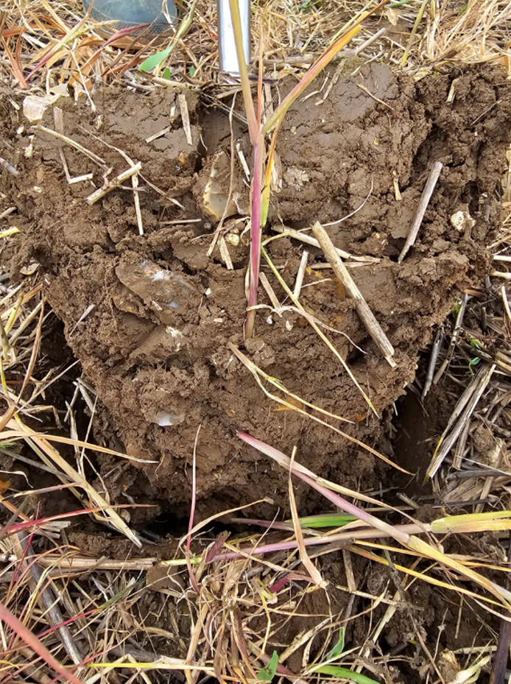
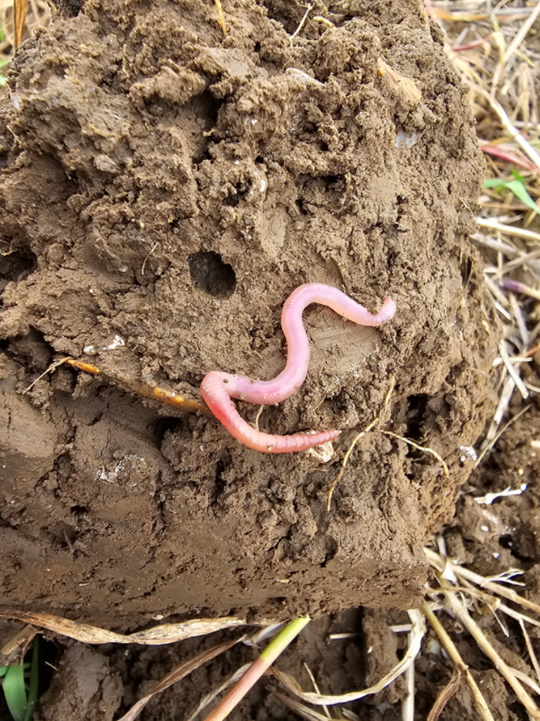
Soil with a High Earthworm Count
organic matter form the surface taken deep into the soil
Worm holes
Healthy worms
Overall soil structure

Slide 10
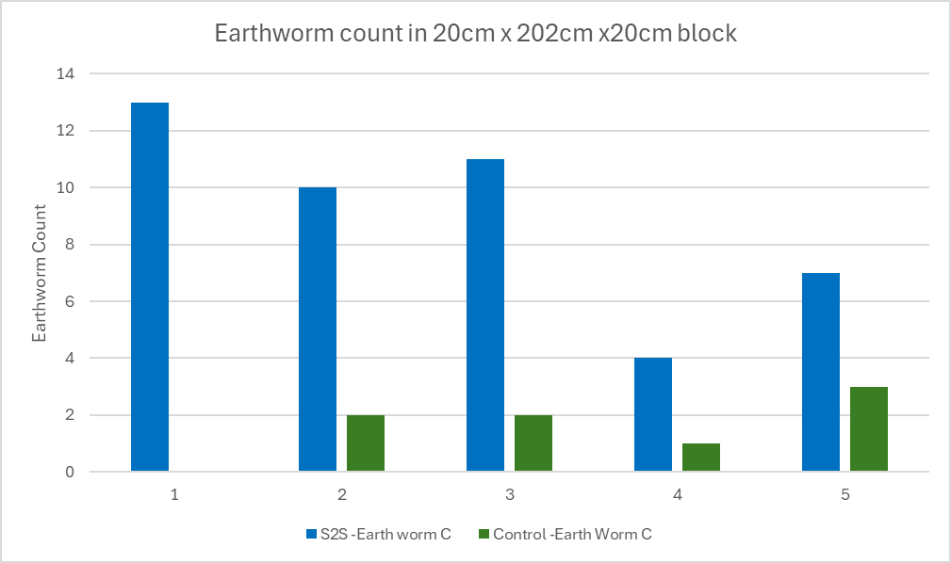
Earthworms
Sea2Soil soils had an average earthworm count of 9.0 Vs the control soils at 1.6
5 times the amount of worms

Slide 11
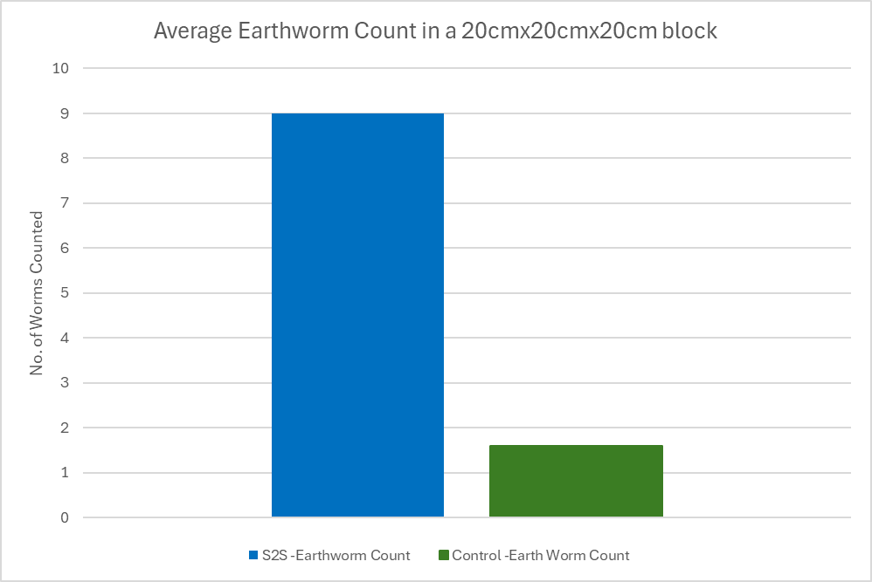
Earthworms
It is common to see an immediate marked increase in earthworm numbers following the application of Sea2Soil.
It is likely they recognise the amino acids and fatty acids in Sea2Soil as an easily digestible and nutritious food source
Or 2.25M worms/Ha on the Sea2Soil farm, verses 400k worms/Ha on the “synthetically” farmed land

Slide 12
Soil Porosity
Soil porosity is a critical property of soil that refers to the volume of pore spaces between soil particles. These pore spaces can be filled with air or water, and the size and distribution of these pores have significant implications for various soil functions.
Soil porosity is vital for maintaining a balance of water, air, and nutrients within the soil, all of which are essential for plant growth, soil health, and the overall functioning of terrestrial ecosystems.

Slide 13
Why is Soil Porosity Important?
Water Infiltration and Drainage
  Soil porosity determines how quickly water can infiltrate the soil and how well the soil can drain excess water. High porosity soils allow for better water infiltration and reduce surface runoff, which helps prevent erosion and flooding. Good drainage also prevents waterlogging, which can harm plant roots and reduce oxygen availability.
Root Penetration and Growth
  Plants need space for their roots to grow and expand. High porosity in soil allows roots to penetrate more easily and access water and nutrients deeper in the soil profile. This supports healthier and more robust plant growth.
Nutrient Availability
  Soil pores hold water and dissolved nutrients that plant roots can absorb. The balance between large (macropores) and small (micropores) pores influences how well the soil retains and releases nutrients.
Microbial Activity
  oil microorganisms, which play a key role in decomposing organic matter and nutrient cycling, require a habitat with sufficient air and water. Soil porosity creates the necessary environment for these microorganisms to thrive and contribute to soil health.
Soil Compaction Loss
  Low porosity often indicates compacted soil, which can hinder root growth, reduce water infiltration, and limit air exchange. Maintaining good porosity helps prevent compaction and ensures that the soil remains loose and friable.

Slide 14
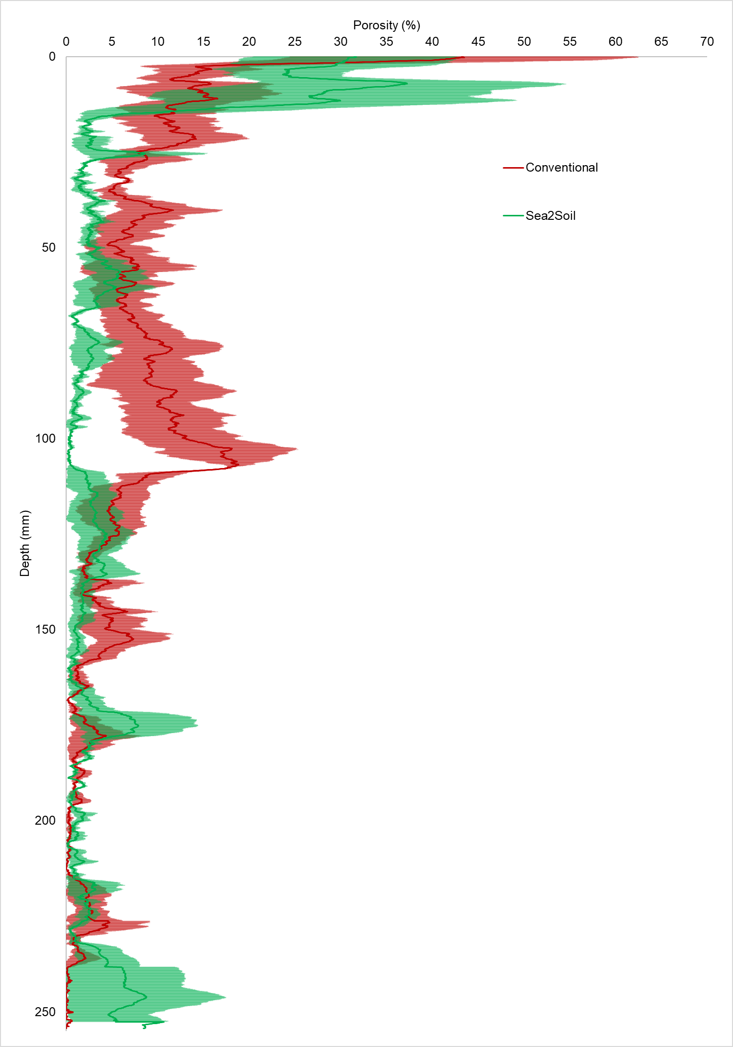
Soil Porosity
Sea2Soil is more porous at the surface
Conventional farming has more porosity due to the action of the plough
Compaction ridge at the depth of the plough
Sea2Soil is more porous at lower depths

Slide 15
Soil Organic Matter
Soil organic matter (SOM) is a critical component of soil health and fertility, encompassing a range of organic compounds from living, dead, and decomposed organisms.
Soil Organic Matter consists of
Living Organisms
  This includes a variety of soil biota such as bacteria, fungi, protozoa, nematodes, and earthworms.
Dead Organic Material
  Plant residues, animal remains, and microbial biomass fall into this category. This material is in various stages of decomposition.
Humus
  Humus is the stable fraction of organic matter that has decomposed to the point where it resists further breakdown. It plays a key role in maintaining soil structure, moisture, and nutrient retention.

Slide 16
The Importance of Soil Organic Matter
Nutrient Supply
  SOM is a reservoir of nutrients essential for plant growth, including nitrogen, phosphorus, potassium, sulphur, and micronutrients. As organic matter decomposes, these nutrients are mineralized and made available to plants.
Soil Structure
  Organic matter helps to bind soil particles into aggregates, improving soil structure. This enhances porosity, aeration, water infiltration, and root penetration.
Water Retention
  SOM increases the soil’s ability to retain moisture. Organic matter can hold many times its weight in water, which is crucial during dry periods.
Microbial Activity
  Organic matter serves as a food source for soil microorganisms, fostering a diverse and active microbial community. These microbes play key roles in nutrient cycling and organic matter decomposition.
Carbon Sequestration
  Soil organic matter stores carbon, helping to mitigate climate change by reducing atmospheric carbon dioxide levels.

Slide 17
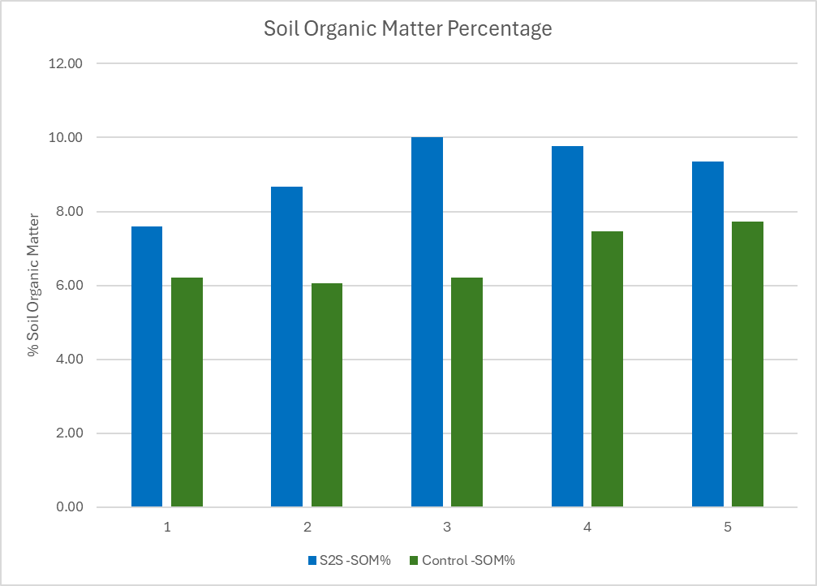
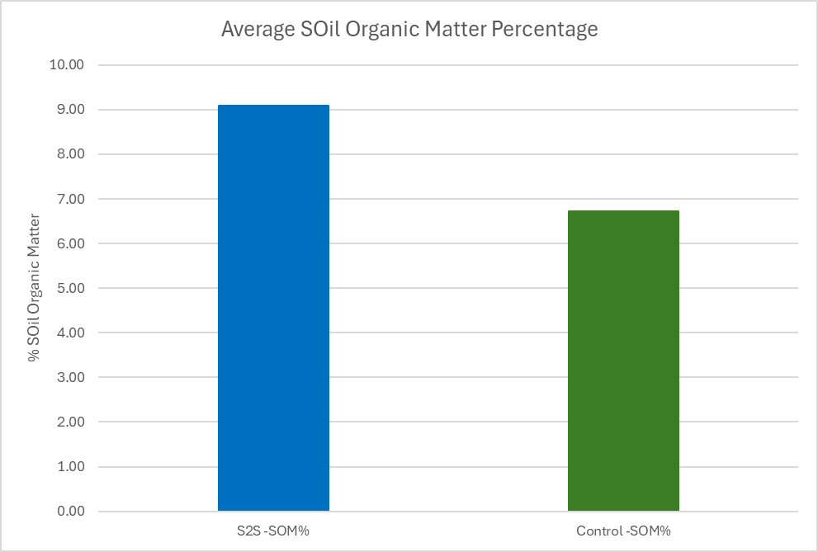
Soil Organic Matter
A significant increase in Soil Organic Matter content (p=0.003)
Sea2Soil soils had a SOM of 9.1% Vs the control soils at 6.7%

Slide 18
Total Soil Carbon Content
Total soil carbon refers to the sum of all carbon forms found within the soil. It is a key indicator of soil health and fertility, contributing to various soil functions and ecosystem services. Total soil carbon is composed of two main fractions:
1. Soil Organic Carbon (SOC)
SOC is the carbon component of soil organic matter (SOM). It includes:
  Living Organisms: Microorganisms, roots, insects, and other fauna.
  Dead Organic Material: Partially decomposed plant and animal residues.
  Humus: Stable, fully decomposed organic matter.
2. Soil Inorganic Carbon (SIC)
SIC is the carbon found in mineral forms, primarily as carbonates, including:
  Carbonates: Such as calcium carbonate (CaCO3) and magnesium carbonate (MgCO3).
  Bicarbonates: Present in soils with alkaline pH, typically in arid and semi-arid regions.

Slide 19
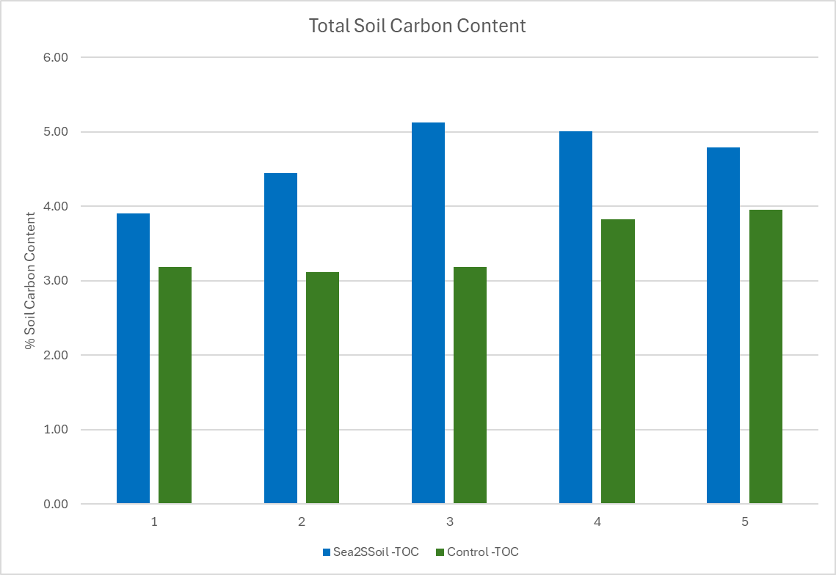
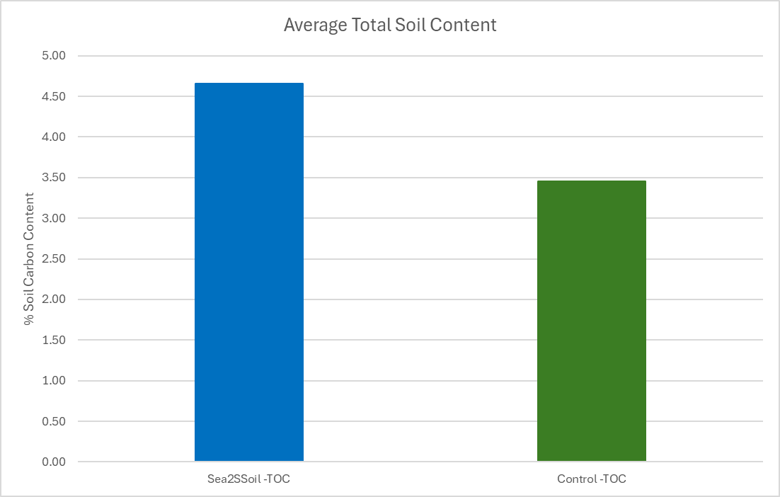
Total Soil Carbon Content
Sea2Soil soils had a TOC of 4.65% Vs the control soils at 3.45% (p = 0.003)
The change of 1.2% is substantial considering the comparatively short time.

