Slide 1
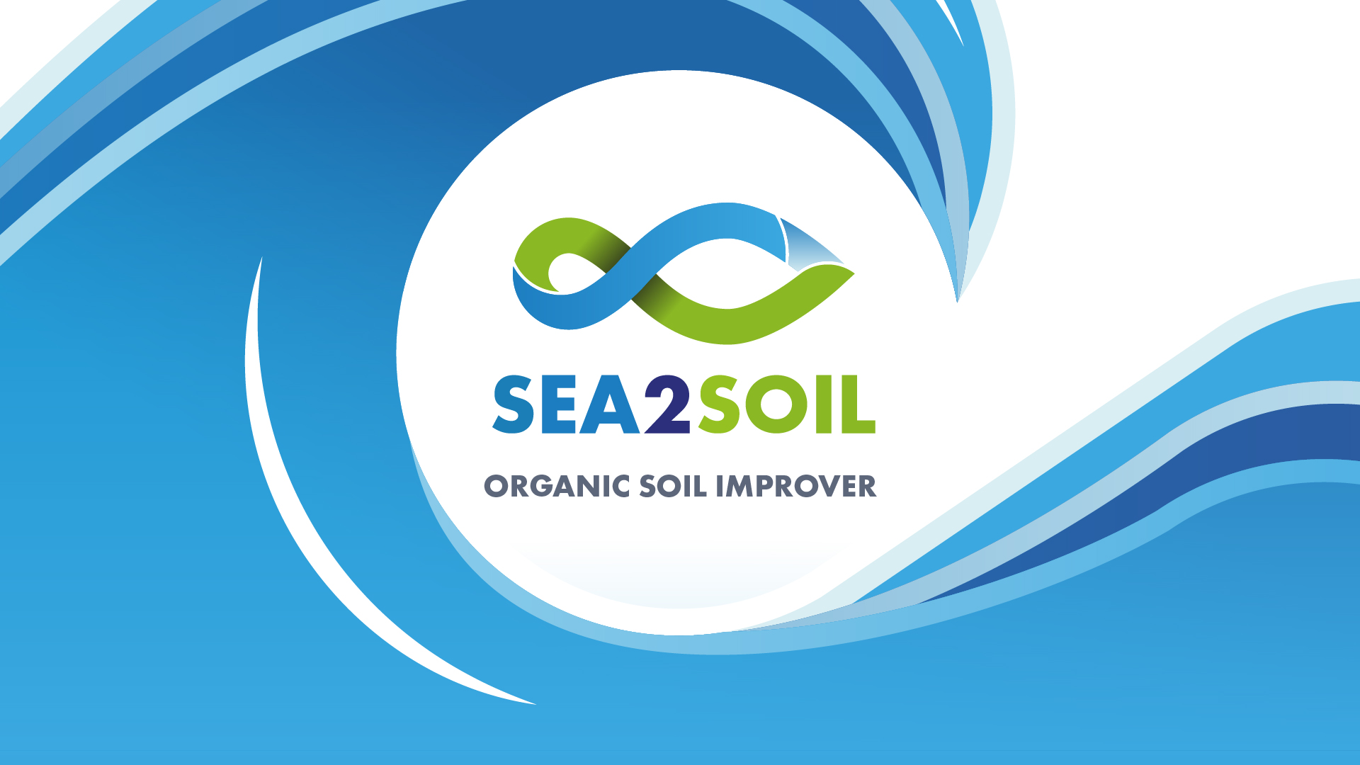

Slide 2
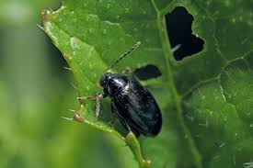
Cabbage Stem Flea Beetle
Cabbage stem flea beetle (CSFB) is the most important pest of winter oilseed rape.
Since 2013, when neonicotinoid-treated seed was withdrawn from use in this crop, CSFB management has become far more challenging. Widespread resistance to pyrethroids has also limited the effectiveness of this chemical control option.
The lack of chemical control exposed significant knowledge gaps in pest biology and phenology, including an understanding of the factors that influence adult migration and larval invasion, and the relationship between larval load and crop damage.

Slide 3
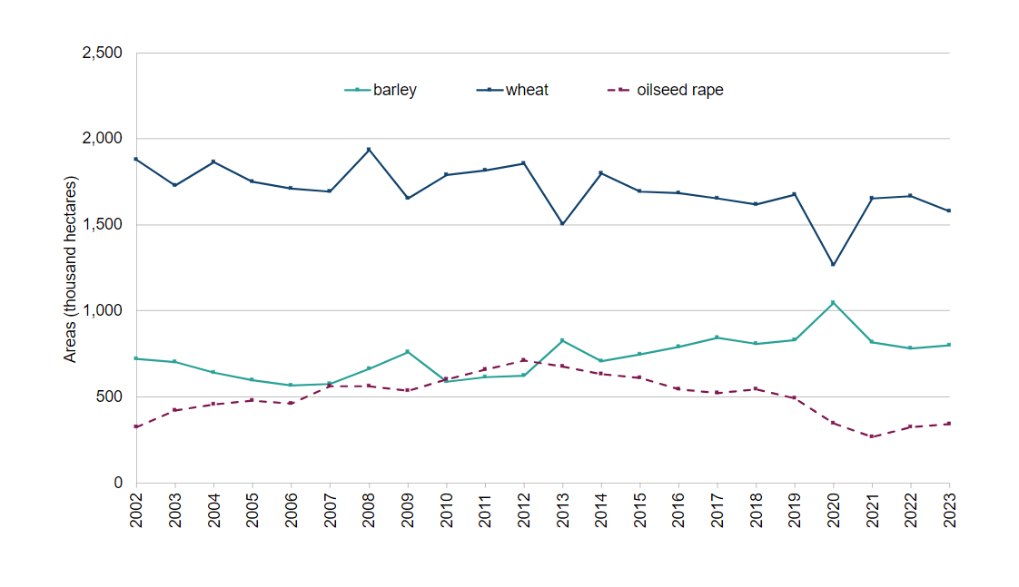
Cropping Area
Area of wheat, barley and oilseed rape in England at 1 June (thousand hectares)
Cereal and oilseed rape areas in England at 1 June 2023 - GOV.UK (www.gov.uk)

Slide 4
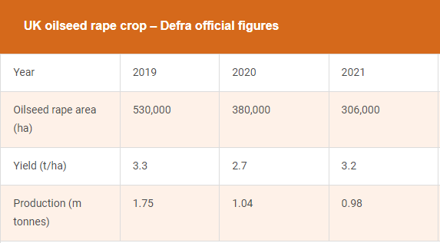
Financial loss due to CSFB
2019
Average price 2019 £322.50 (AHDB source)
Total income to UK farming industry: £564.4M
2021
Average price 2021 £354.50 (AHDB source)
Total income to UK farming industry: £347.4M
Total Farming loss due the increase of CSFB: £217Million
Harvest 2023: Some good oilseed rape yields but most are down - Farmers Weekly (fwi.co.uk)

Slide 5
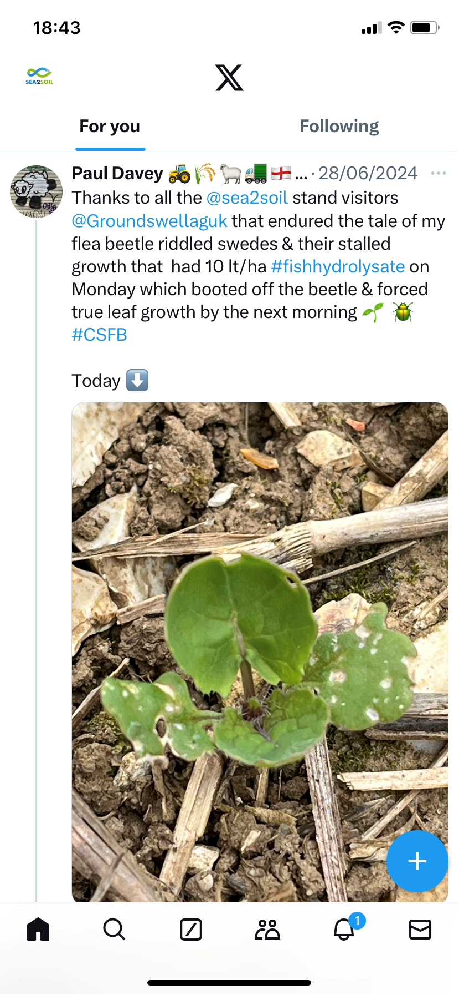
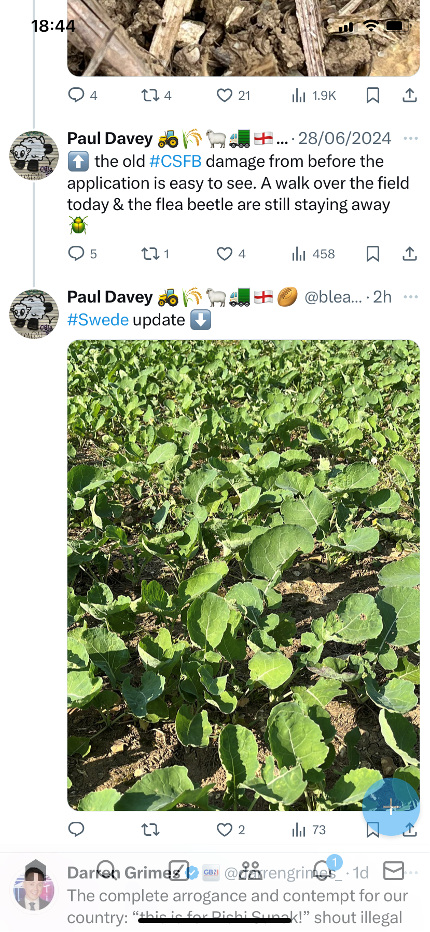
Can Sea2Soil help?
Since 2021 farmers have reported that since they have been using Sea2Soil they have seen a significant reduction in CSFB.
After applying Sea2Soil to half of one field and not the other, the treated half looked healthier and showed a significant yield increase when harvested. Andrew, Elsham Estates

Slide 6

NIAB Partnership

Slide 7
Objectives of initial glass house trial
Laboratory screening of Pelagia’s “Sea2Soil” for efficacy against cabbage stem flea beetle (Phyllortreta Cruciferae).

Slide 8
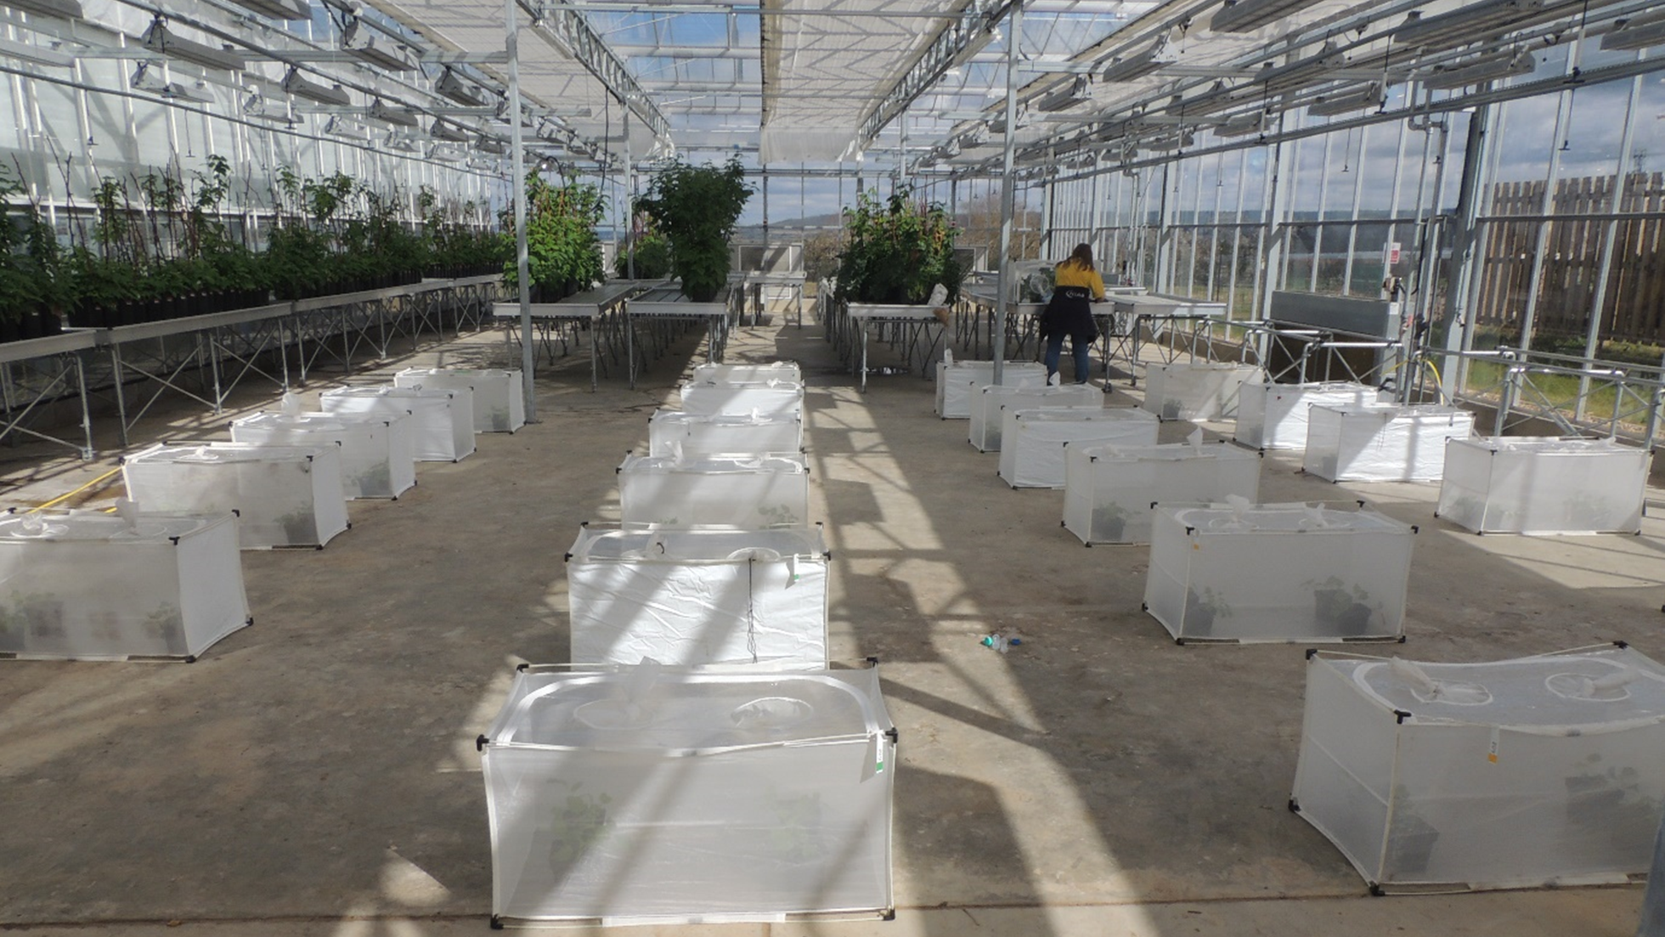
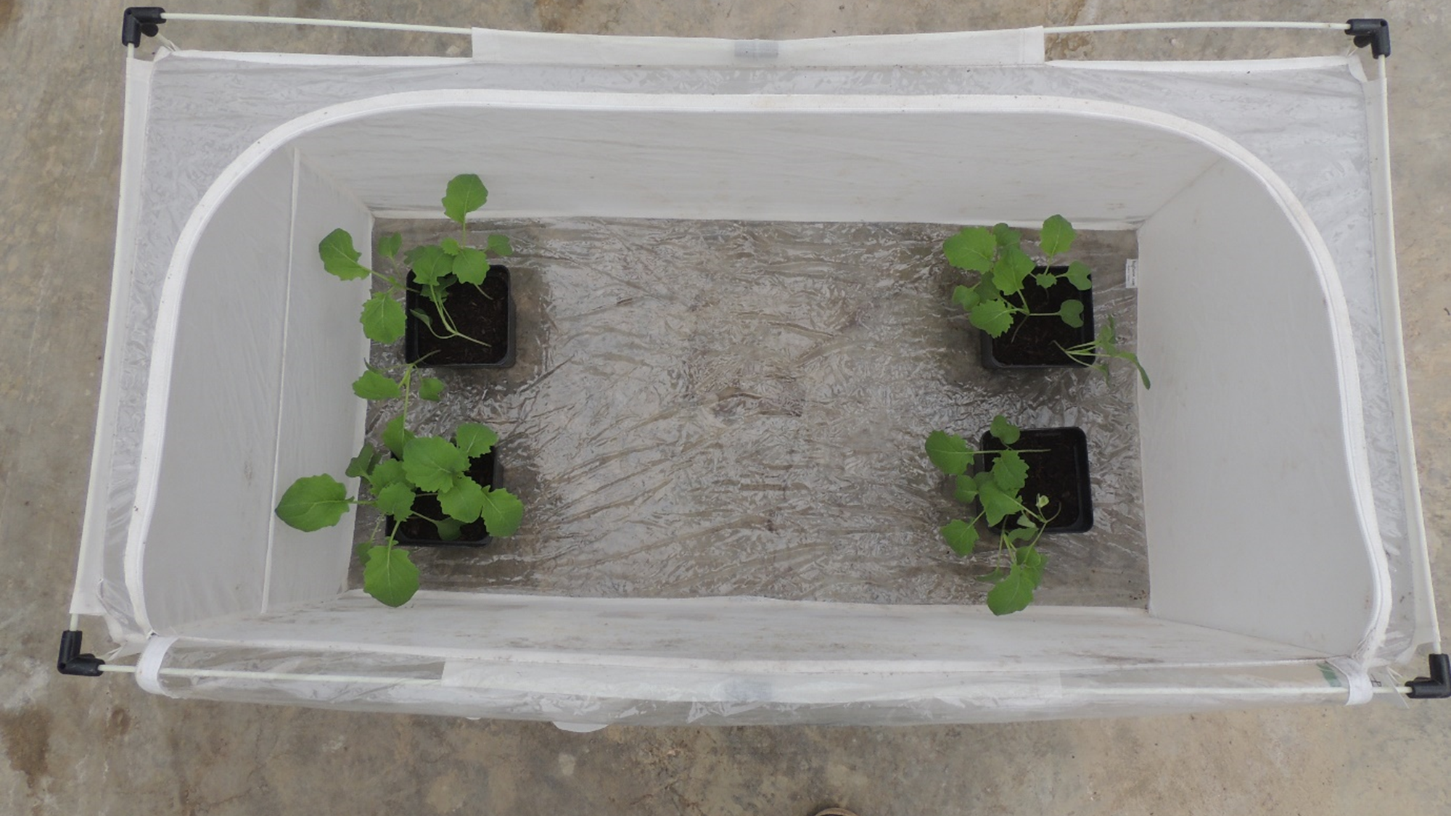
Materials and Method
A complete randomised block design of 6 replicates of 4 treatments.
Each plot consisted of 1m x 0.5m x 0.5m BugDorn cage.
Each cage had 4 pots of Oil Seed Rape (cv Turning), planting density 40-45 plants/M².
Treatments – Untreated, 5L/Ha, 10L/Ha, 20L/Ha
7 CSFBs introduced into each cage

Slide 9
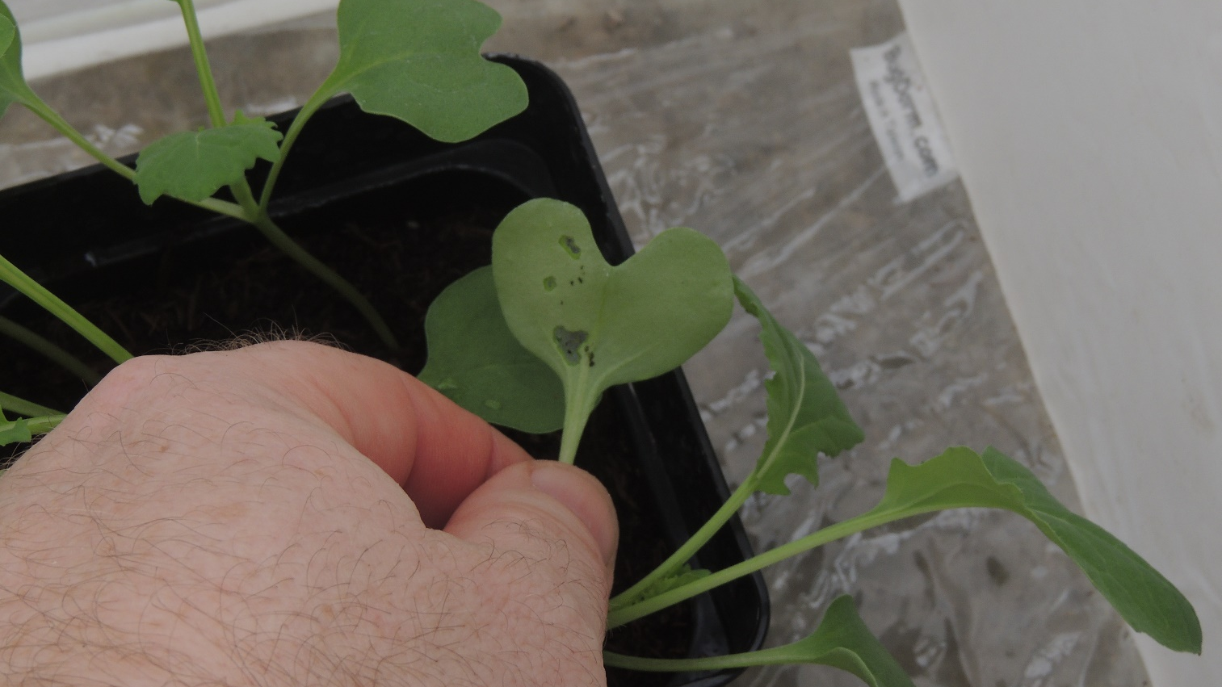
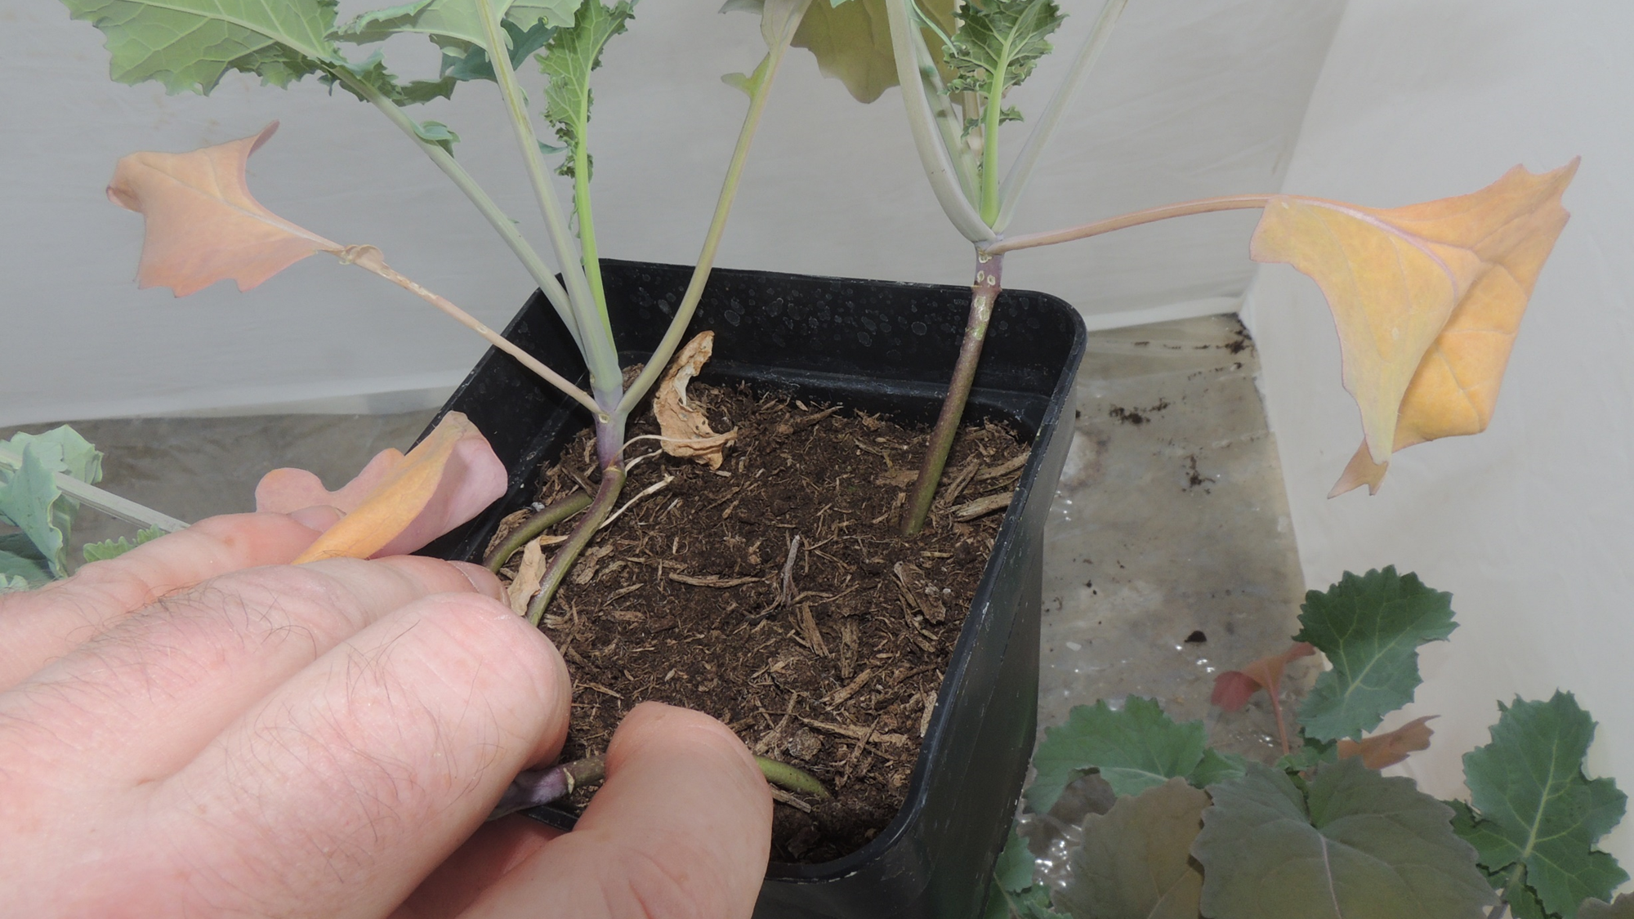
Feeding Assessment
Initial feeding damage as presented on the cotyldons
Later feeding damage as presented on the stems

Slide 10
Results – Beetle location
The beetles would hide in any crevice so not all beetle would be found when assessed.
Analysis showed no significant relationship between the beetle location and whether the plants had been treated with Sea2Soil
In conclusion this was not a good indicator of the repellence of Sea2Soil

Slide 11
Results - Feeding
 | Cotyledons |  |  |  |  | Leaves | Stems
 | Day 1 | Day 2 | Day 7 | Day 11 | Day 12 | Day 12 | Day 12 | Day 16 | Day 22
Untreated | 0.5 | 0.75 | 2.2 | 0 | 0 | 2 | 0.75 | 2.2 | 7
Treated 10L/Ha | 0.5 | 0.6 | 1.5 | 0 | 0.2 | 0.2 | 0 | 1.2 | 2.9
Percentage reduction in feeding | 0.00% | 20.00% | 31.82% |  |  | 90.00% | 100.00% | 45.45% | 58.57%

Slide 12
Results – Beetle Feeding
Sea2Soil applied at half, full and double field rates shows a significant reduction in the feeding of Cabbage stem flea beetles on cotyledons within 2 days of application
Sea2Soil applied at half, full and double field rates can cause a reduction in feeding damage on cotyledons up to 7 days after application and may convey cover until they senescence
2 applications of Sea2Soil at either half, full or double field rate can deter feeding of Cabbage stem flea beetle on stems, but as stem feeding is slow this can take up to 12 days after a second application for the differences to become evident

Slide 13
Conclusion
Further work to be carried out
  Field scale
Initial trails indicate that Sea2Soil reduces the feeding of the CSFB on OSR plants
Application rates are optimal at 10L/Ha every 7days

